Slide 1

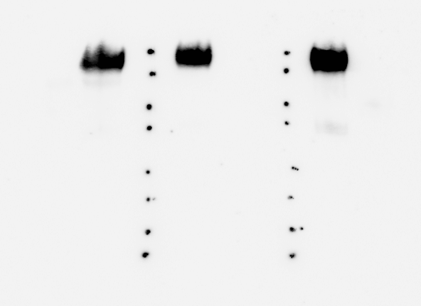
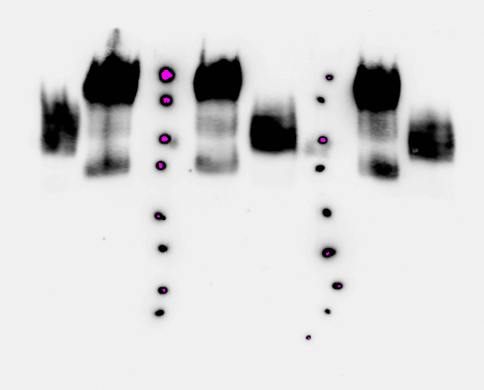
ReliaTech GmbH
Rabbit anti-human CEACAM-1
„Carcinoembryonic antigen-related cell adhesion molecule-1“
(Cat #102-PA100S/-PA100 / #102-PA102S/-PA102)
CEACAM8
CEACAM1
CEACAM1
CEACAM1
CEACAM8
CEACAM1
CEACAM1
CEACAM8
CEACAM8
CEACAM8
kDa
250
130
95
72
55
36
28
17
Anti-human CEACAM1 (1-4)
[#102-PA100]
Anti-human CEACAM1 (ΔN)
[#102-PA102]
Anti-human CEACAM (Competitor) binding both human CEACAMs
The antibodies were raised in rabbits immunized with two different forms of highly pure recombinant CEACAM1 consisting of the first 1-4 domains (#102-PA100) and of the truncated N-terminal form (#102-PA102) of CEACAM1. Both antibodies recognize CEACAM1 but not CEACAM8. Cross reaction with CEACAM3, CEACAM4, CEACAM5, CEACAM6 und CEACAM7 are not tested so far.
The experiment was performed by Dr. Bernhard Singer, University Hospital Essen, Germany
http://www.reliatech.de / orders@reliatech.de

